Slide 1
MUSIC SEARCH ENGINE
Sharan Babu, SXP141731@utdallas.edu
Aditya Mahajan, AXM156630@utdallas.edu
Sairam Praneeth Vegesana, PSV150030@utdallas.edu
Harshil Shah, HXS155030@utdallas.edu
Varun Muthanna, VKM150030@utdallas.edu

Slide 2
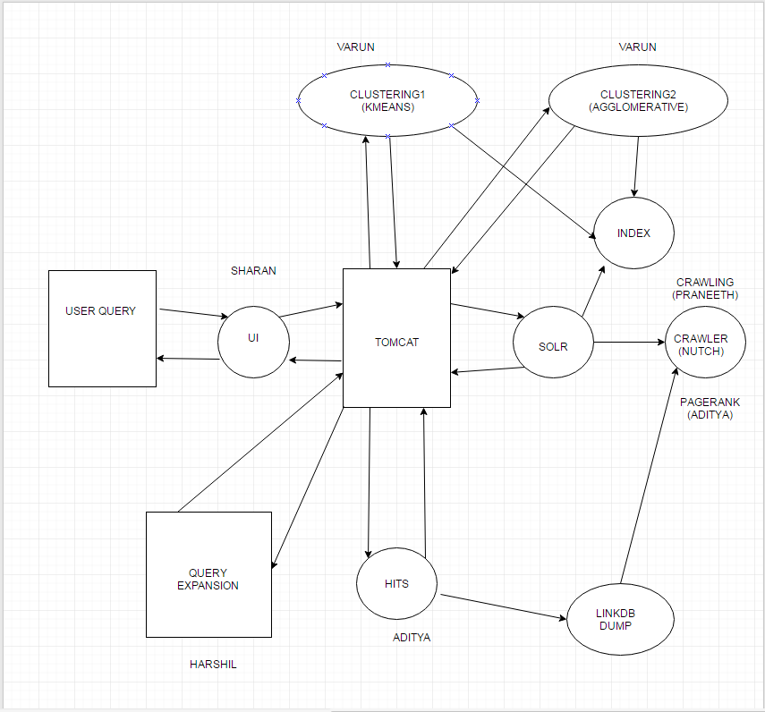
PROJECT ARCHITECTURE

Slide 3
CONCLUSION
Crawled around 1,286,377 web pages and fetched 166,180 web pages.
Apache Nutch was used for crawling the web pages and Lucene Solr was used for Indexing all the fetched documents.
About 200 queries were used for purposes of testing the music search engine.
Using open source crawler and indexer helped in the smooth implementation of the project.
Having implemented this project gave us an insight on how large scale search engines work.

